Slide 1
Professor Dimitrios Melissourgos
CIS 337 - NETWORK SYSTEMS MANAGEMENT
Midterm 2 Answers

Slide 2
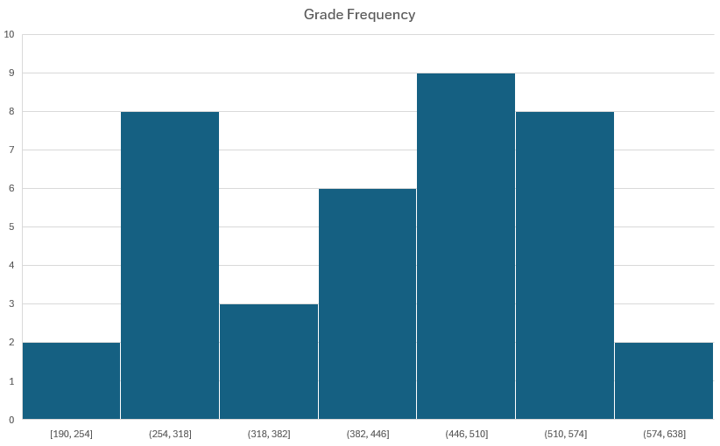
38 students in 2 sections 24 questions 54 minutes average submission time 2.25 minutes per question average 70% average score (418 out of 600) 448 out of 600 median score

Slide 3
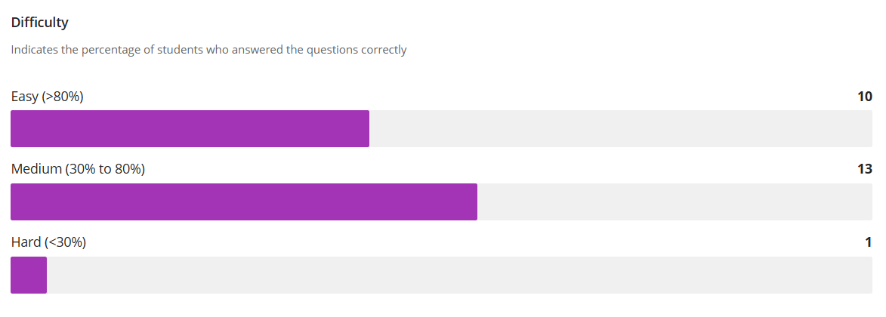
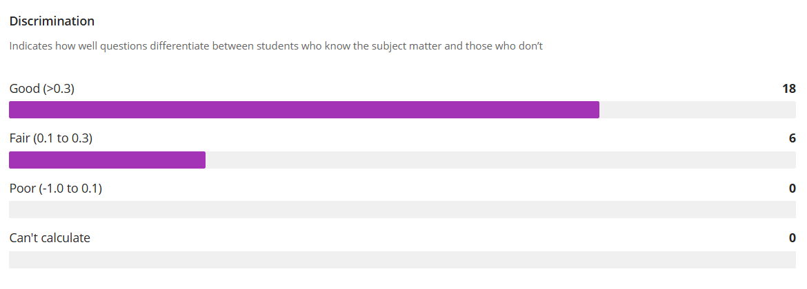

Slide 4
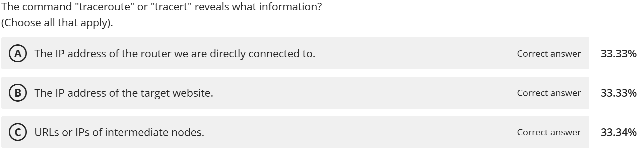
63.77% Correct

Slide 5
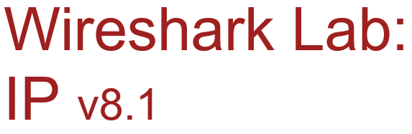
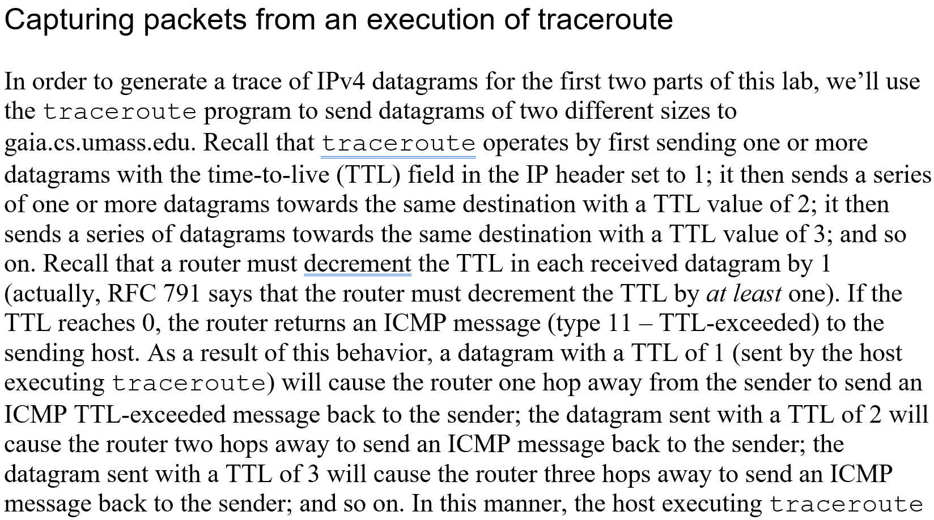

Slide 6
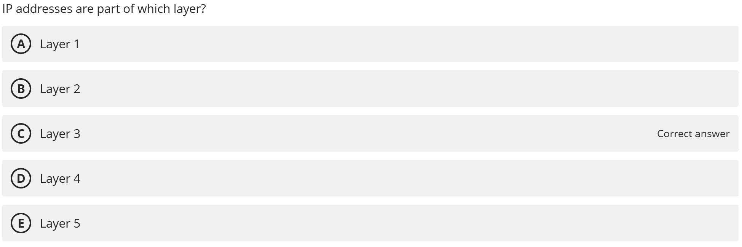
75.95% Correct

Slide 7
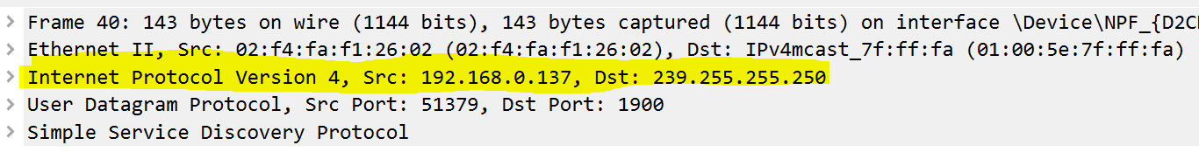

Slide 8
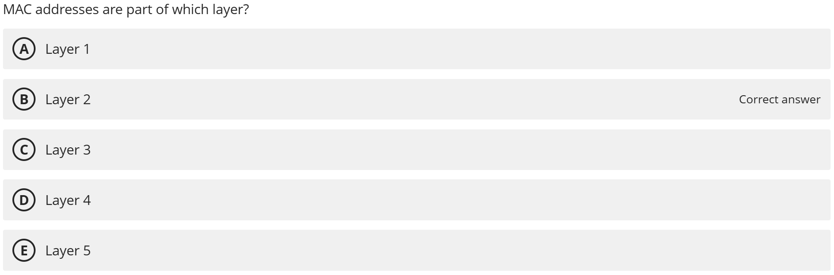
69.28% Correct

Slide 9
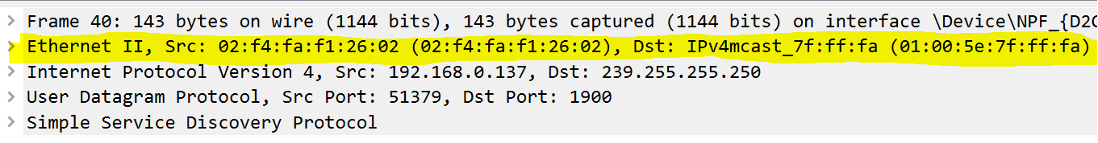

Slide 10
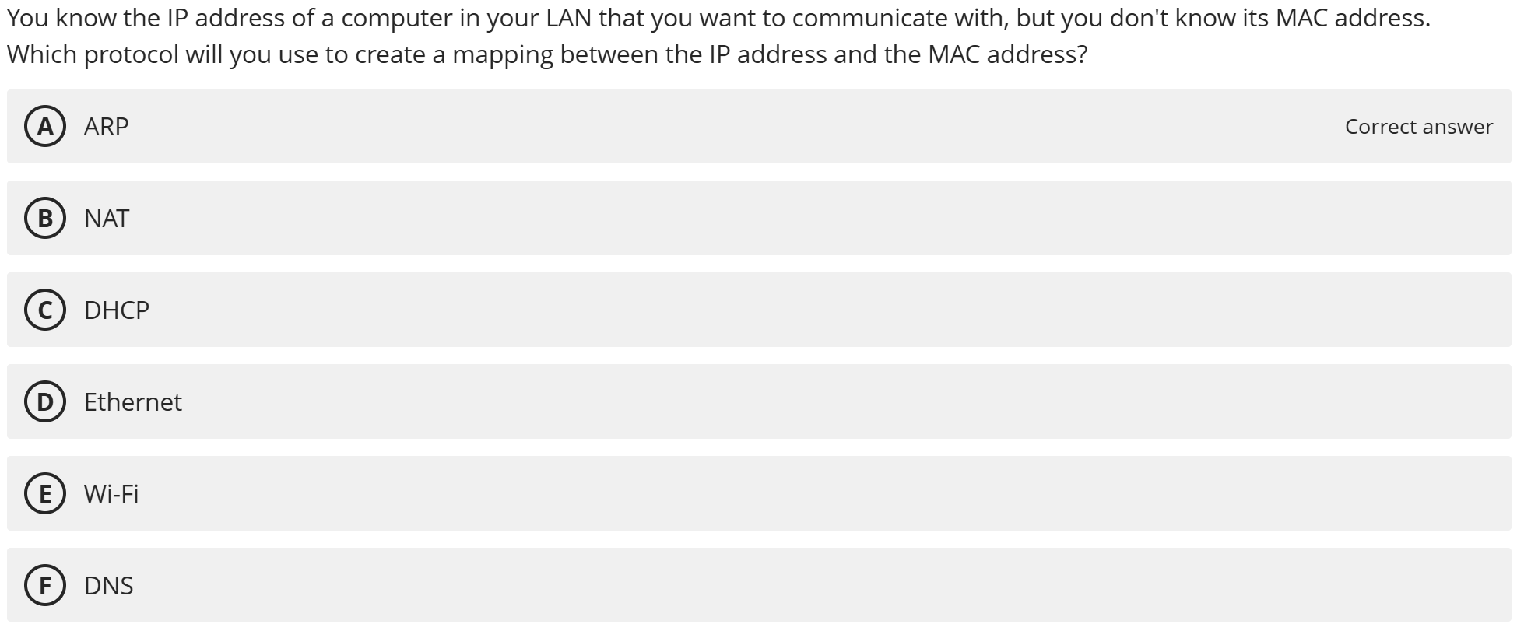
85.81% Correct

Slide 11



ARP: Address Resolution Protocol
Question: how to determine
interface’s MAC address, knowing its IP address?
ARP table: each IP node (host, router) on LAN has table
IP/MAC address mappings for some LAN nodes:
< IP address; MAC address; TTL>
TTL (Time To Live): time after which address mapping will be forgotten (typically 20 min)
137.196.7.78
1A-2F-BB-76-09-AD
137.196.7.23
137.196.7.14
LAN
71-65-F7-2B-08-53
58-23-D7-FA-20-B0
0C-C4-11-6F-E3-98
137.196.7.88

Slide 12
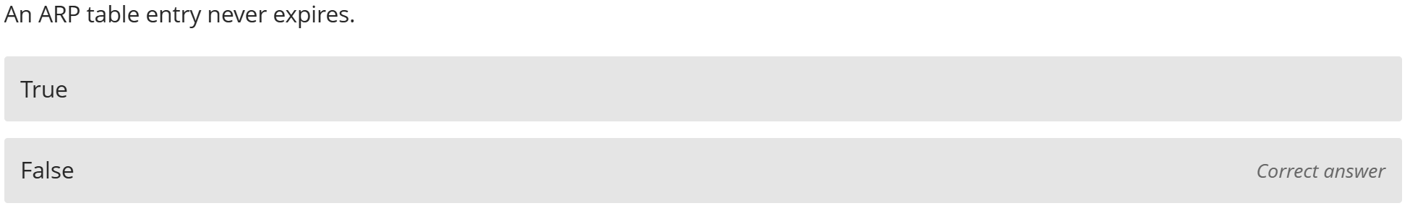
85.81% Correct

Slide 13
ARP: Address Resolution Protocol
Question: how to determine
interface’s MAC address, knowing its IP address?
ARP table: each IP node (host, router) on LAN has table
IP/MAC address mappings for some LAN nodes:
< IP address; MAC address; TTL>
TTL (Time To Live): time after which address mapping will be forgotten (typically 20 min)
137.196.7.78
1A-2F-BB-76-09-AD
137.196.7.23
137.196.7.14
LAN
71-65-F7-2B-08-53
58-23-D7-FA-20-B0
0C-C4-11-6F-E3-98
137.196.7.88

Slide 14
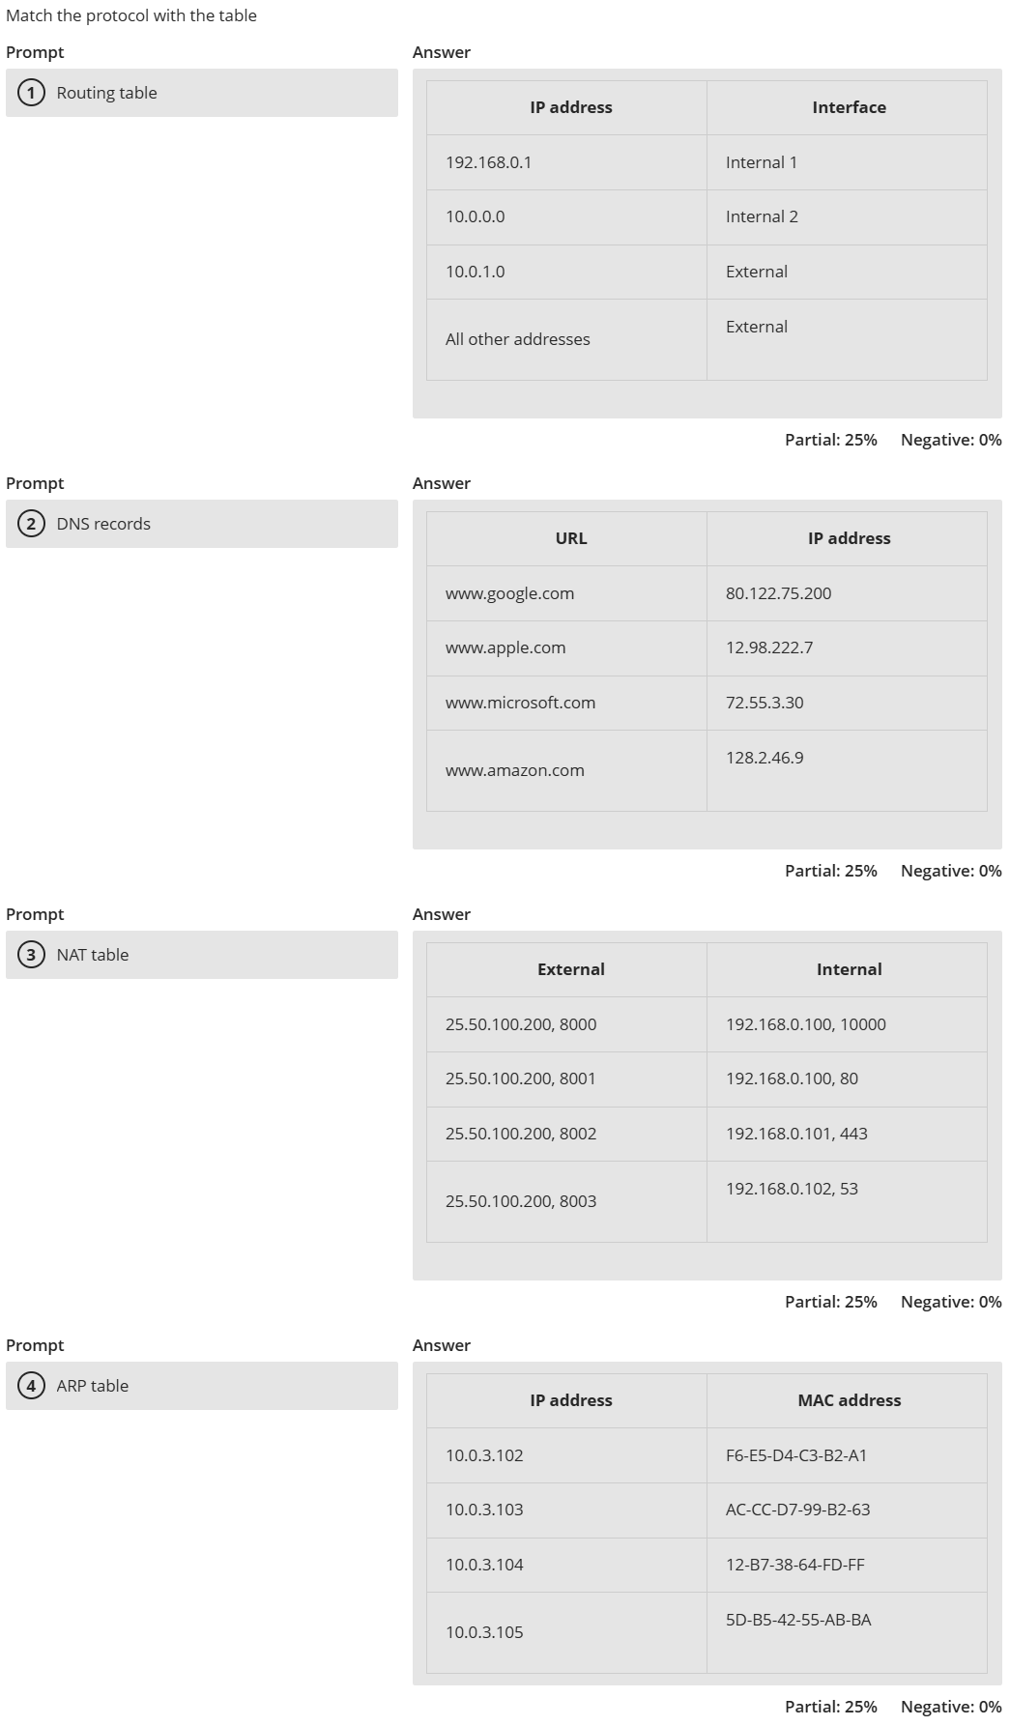
90.15% Correct

Slide 15
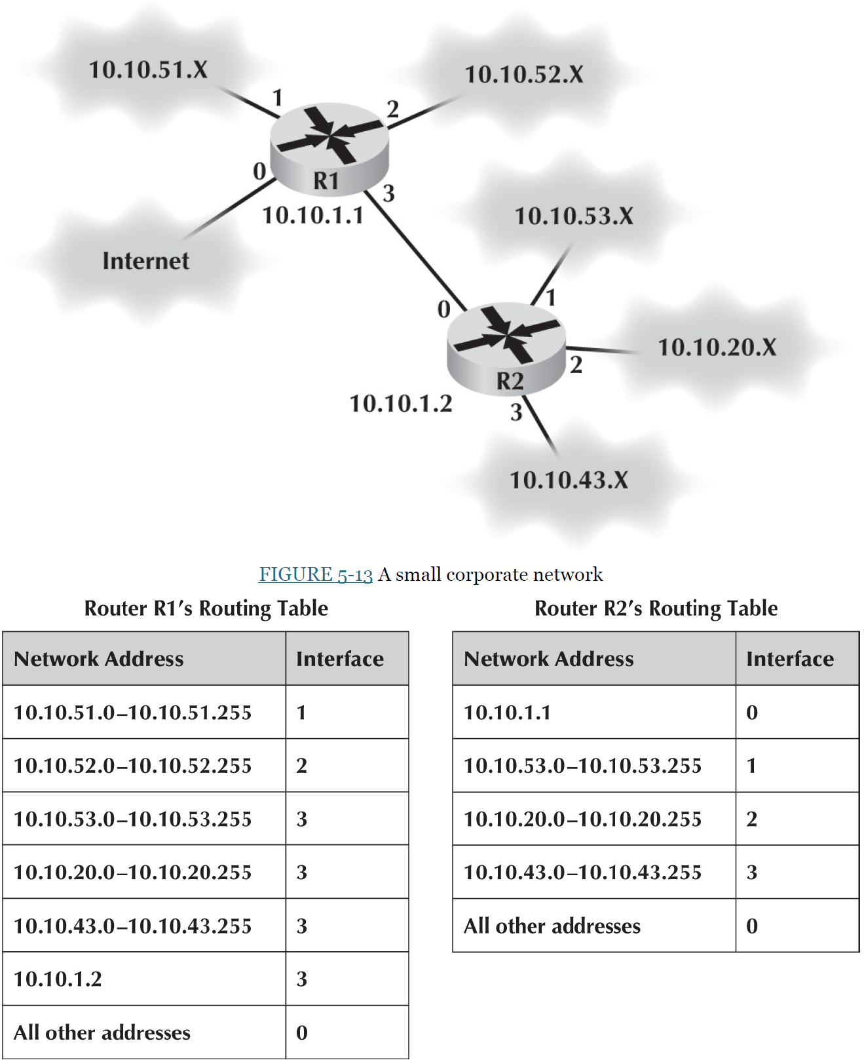

Slide 16
Network Layer Functions
Addressing
Used to direct messages from source to destination
Addresses are assigned in various ways (e.g., by system administrators, ICANN, hardware vendors, etc.)
Addresses exist at different layers
Addresses may be translated (resolved) from one layer to another (e.g., DNS, ARP)
Address Type | Example | Example Address
Application layer | Uniform Resource Locator (URL) | www.indiana.edu
Network layer | IP address | 129.79.78.193 (4 bytes)
Data link layer | MAC address | 1C-6F-65-F8-33-8A (6 bytes)

Slide 17
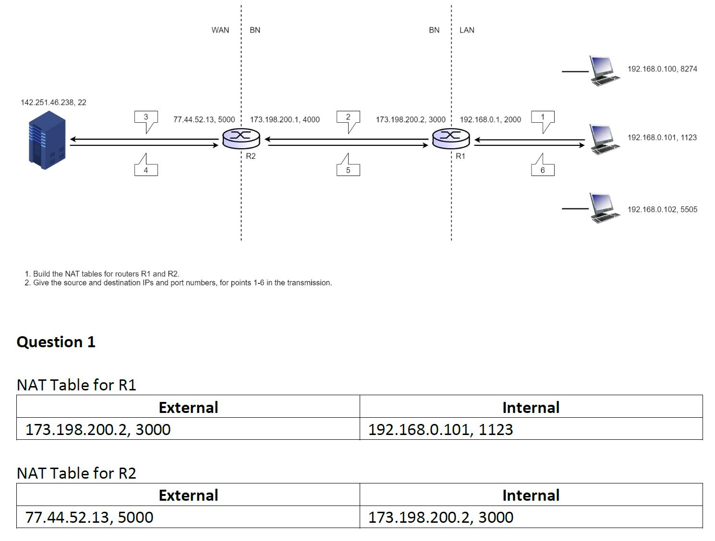
NAT Exercise 1

Slide 18
ARP: Address Resolution Protocol
Question: how to determine
interface’s MAC address, knowing its IP address?
ARP table: each IP node (host, router) on LAN has table
IP/MAC address mappings for some LAN nodes:
< IP address; MAC address; TTL>
TTL (Time To Live): time after which address mapping will be forgotten (typically 20 min)
137.196.7.78
1A-2F-BB-76-09-AD
137.196.7.23
137.196.7.14
LAN
71-65-F7-2B-08-53
58-23-D7-FA-20-B0
0C-C4-11-6F-E3-98
137.196.7.88

Slide 19
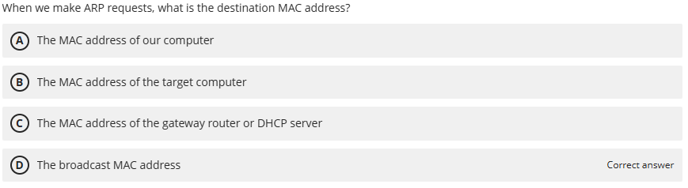
41.74% Correct

Slide 20
ARP protocol: same LAN
A wants to send datagram to B
B’s MAC address not in A’s ARP table.
A broadcasts ARP query packet, containing B's IP address
destination MAC address = FF-FF-FF-FF-FF-FF
all nodes on LAN receive ARP query
B receives ARP packet, replies to A with its (B's) MAC address
frame sent to A’s MAC address (unicast)
A caches (saves) IP-to-MAC address pair in its ARP table until information becomes old (times out)
soft state: information that times out (goes away) unless refreshed
ARP is “plug-and-play”:
nodes create their ARP tables without intervention from net administrator
Notes:
The cost to pay: broadcast traffic. This is one of the limitations for the scalability of LAN. When thinking about LAN, one needs to think about how to deal with the broadcast-based services.
Compared this broadcast scheme with a server based scheme, such as the DHCP server.

Slide 21
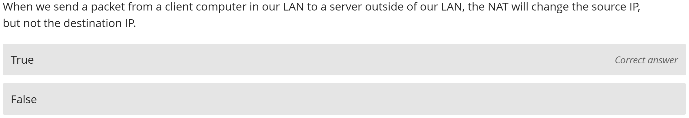
91.31% Correct

Slide 22
NAT: network address translation
implementation: NAT router must:
outgoing datagrams: replace (source IP address, port #) of every outgoing datagram to (NAT IP address, new port #)
. . . remote clients/servers will respond using (NAT IP address, new port #) as destination addr
remember (in NAT translation table) every (source IP address, port #) to (NAT IP address, new port #) translation pair
incoming datagrams: replace (NAT IP address, new port #) in dest fields of every incoming datagram with corresponding (source IP address, port #) stored in NAT table

Slide 23
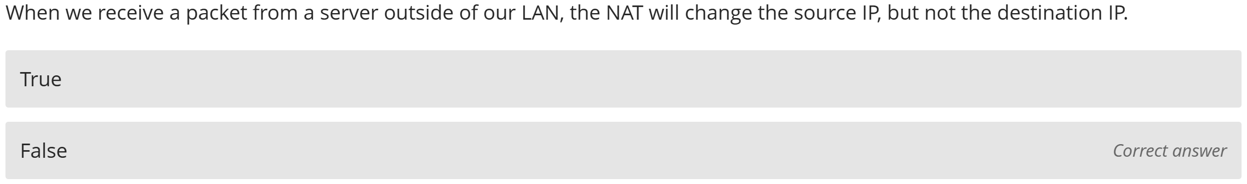
57.25% Correct

Slide 24
NAT: network address translation
implementation: NAT router must:
outgoing datagrams: replace (source IP address, port #) of every outgoing datagram to (NAT IP address, new port #)
. . . remote clients/servers will respond using (NAT IP address, new port #) as destination addr
remember (in NAT translation table) every (source IP address, port #) to (NAT IP address, new port #) translation pair
incoming datagrams: replace (NAT IP address, new port #) in dest fields of every incoming datagram with corresponding (source IP address, port #) stored in NAT table

Slide 25
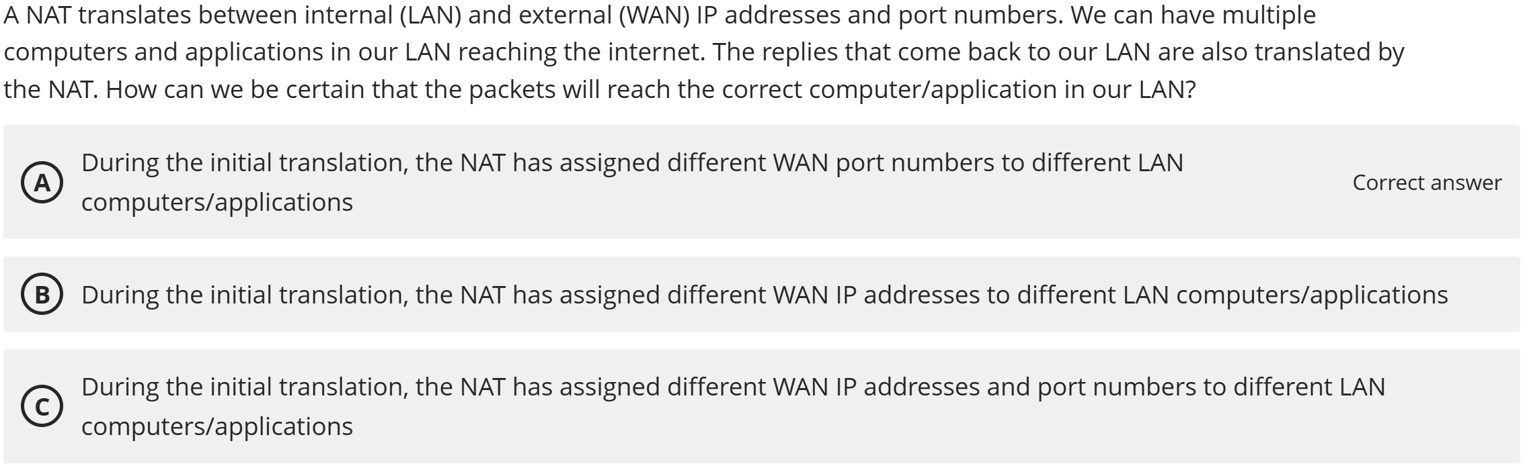
17.54% Correct

Slide 26
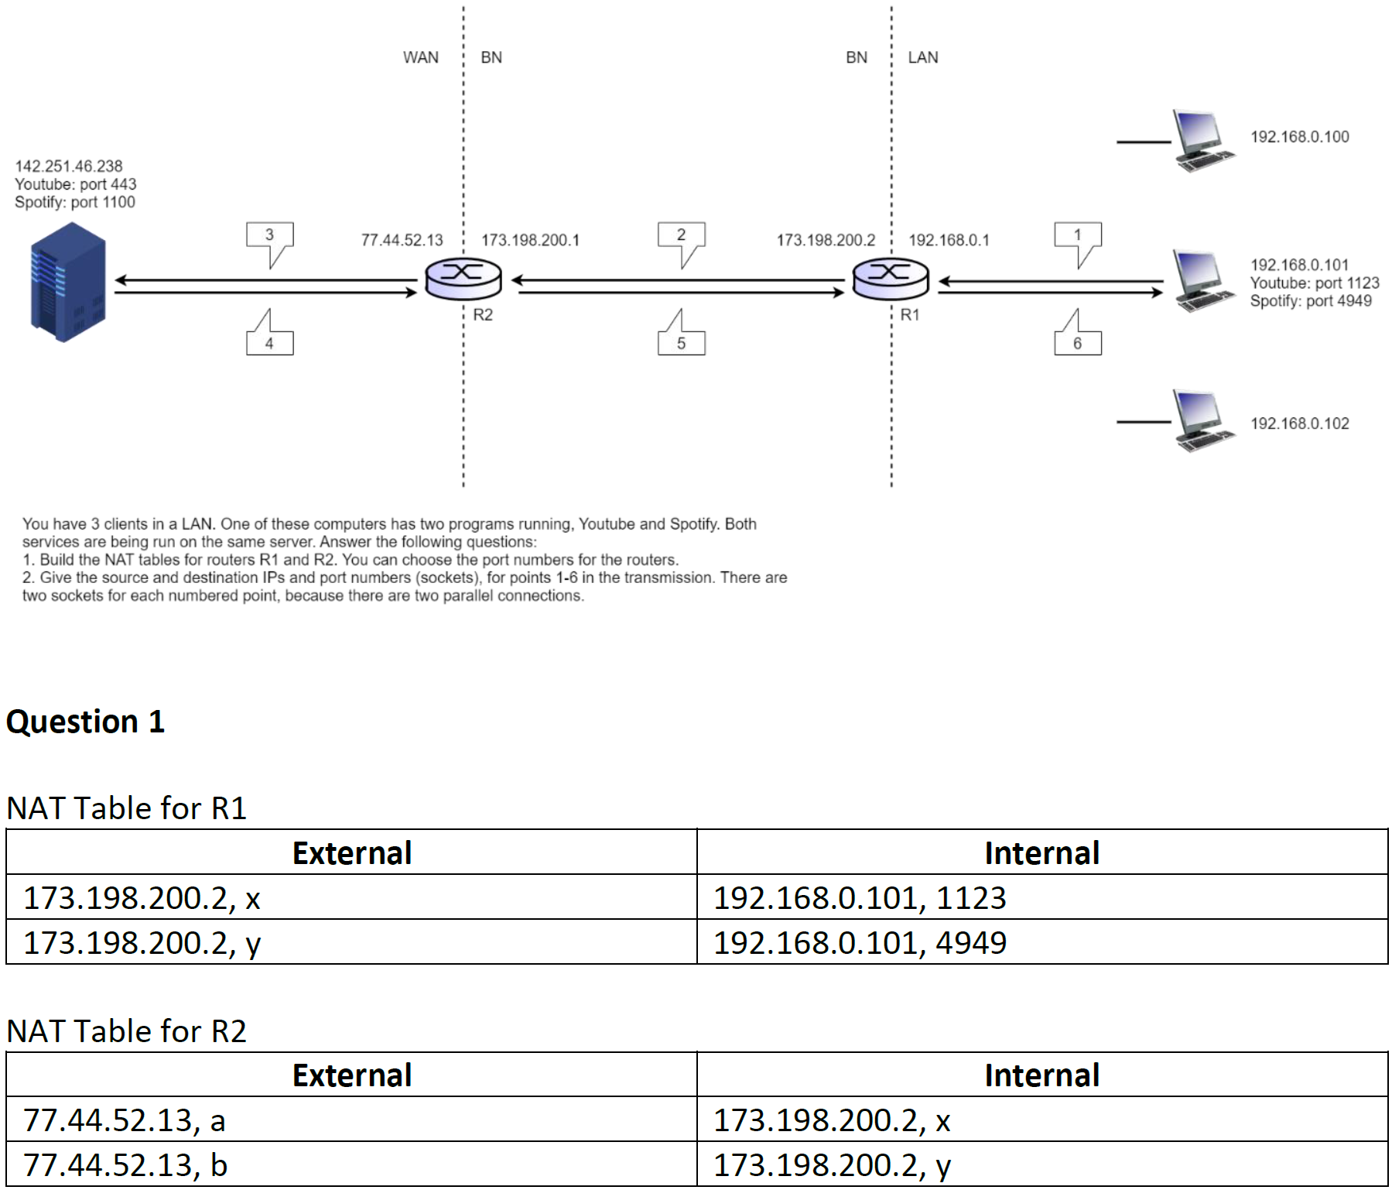
NAT Exercise 2

Slide 27
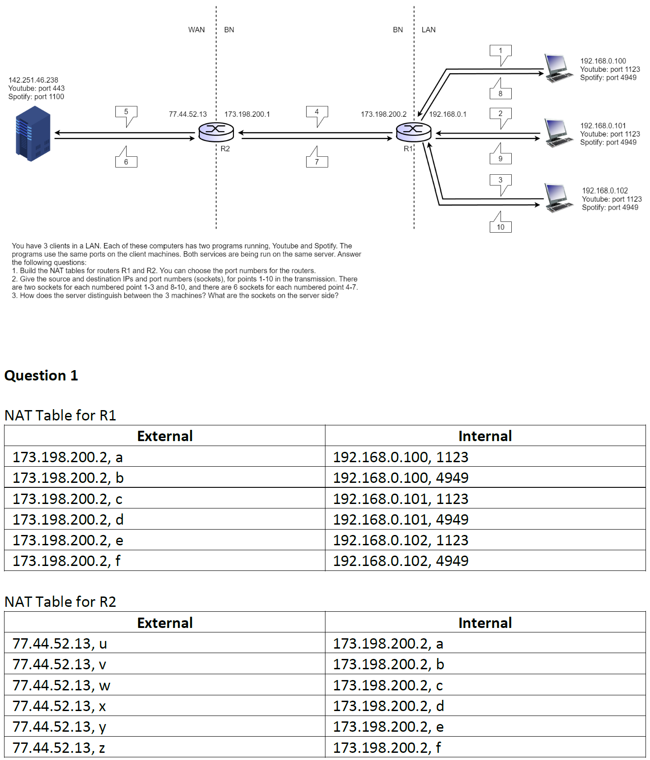
NAT Exercise 3

Slide 28
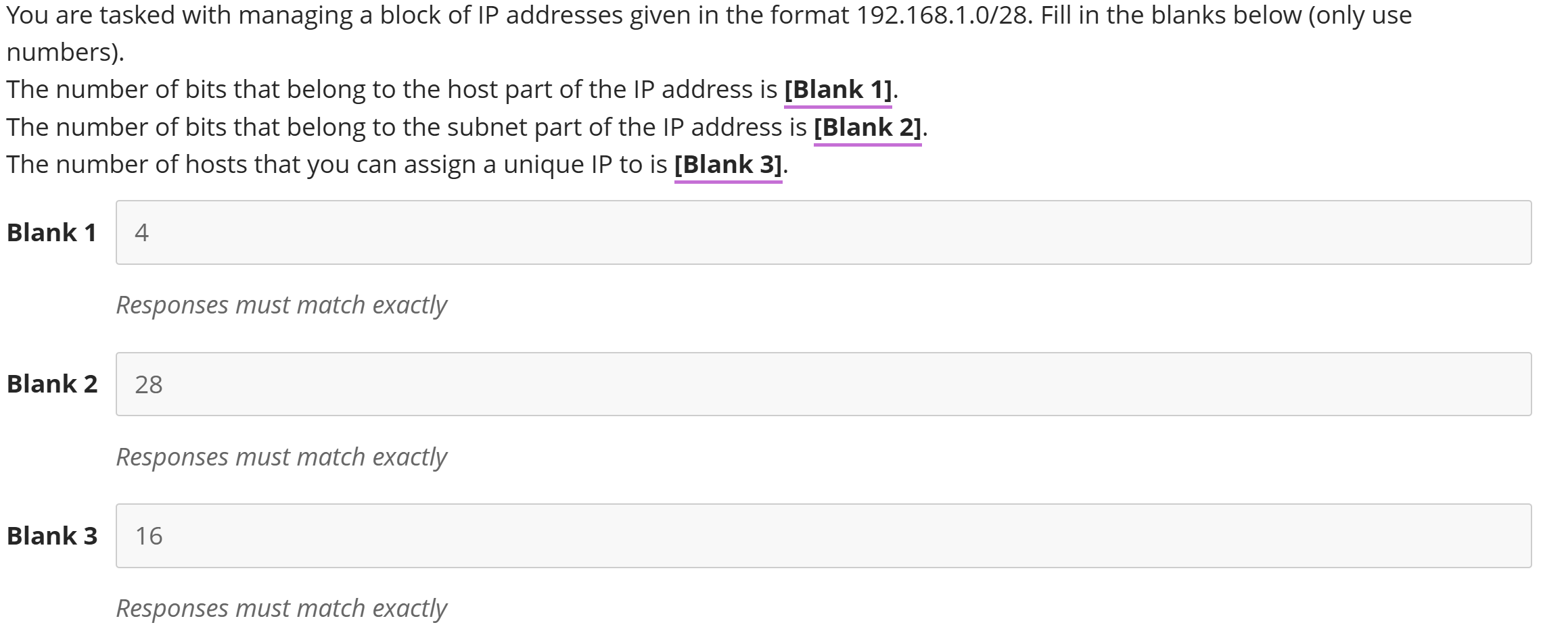
58.22% Correct

Slide 29
IP address
subnet portion of address can have arbitrary length, set by network admin
address format: a.b.c.d/x, where x is # bits in subnet portion of address
subnet
part
host
part
10001000 00010111 00010000 00000000
136.23.16.0/23

Slide 30
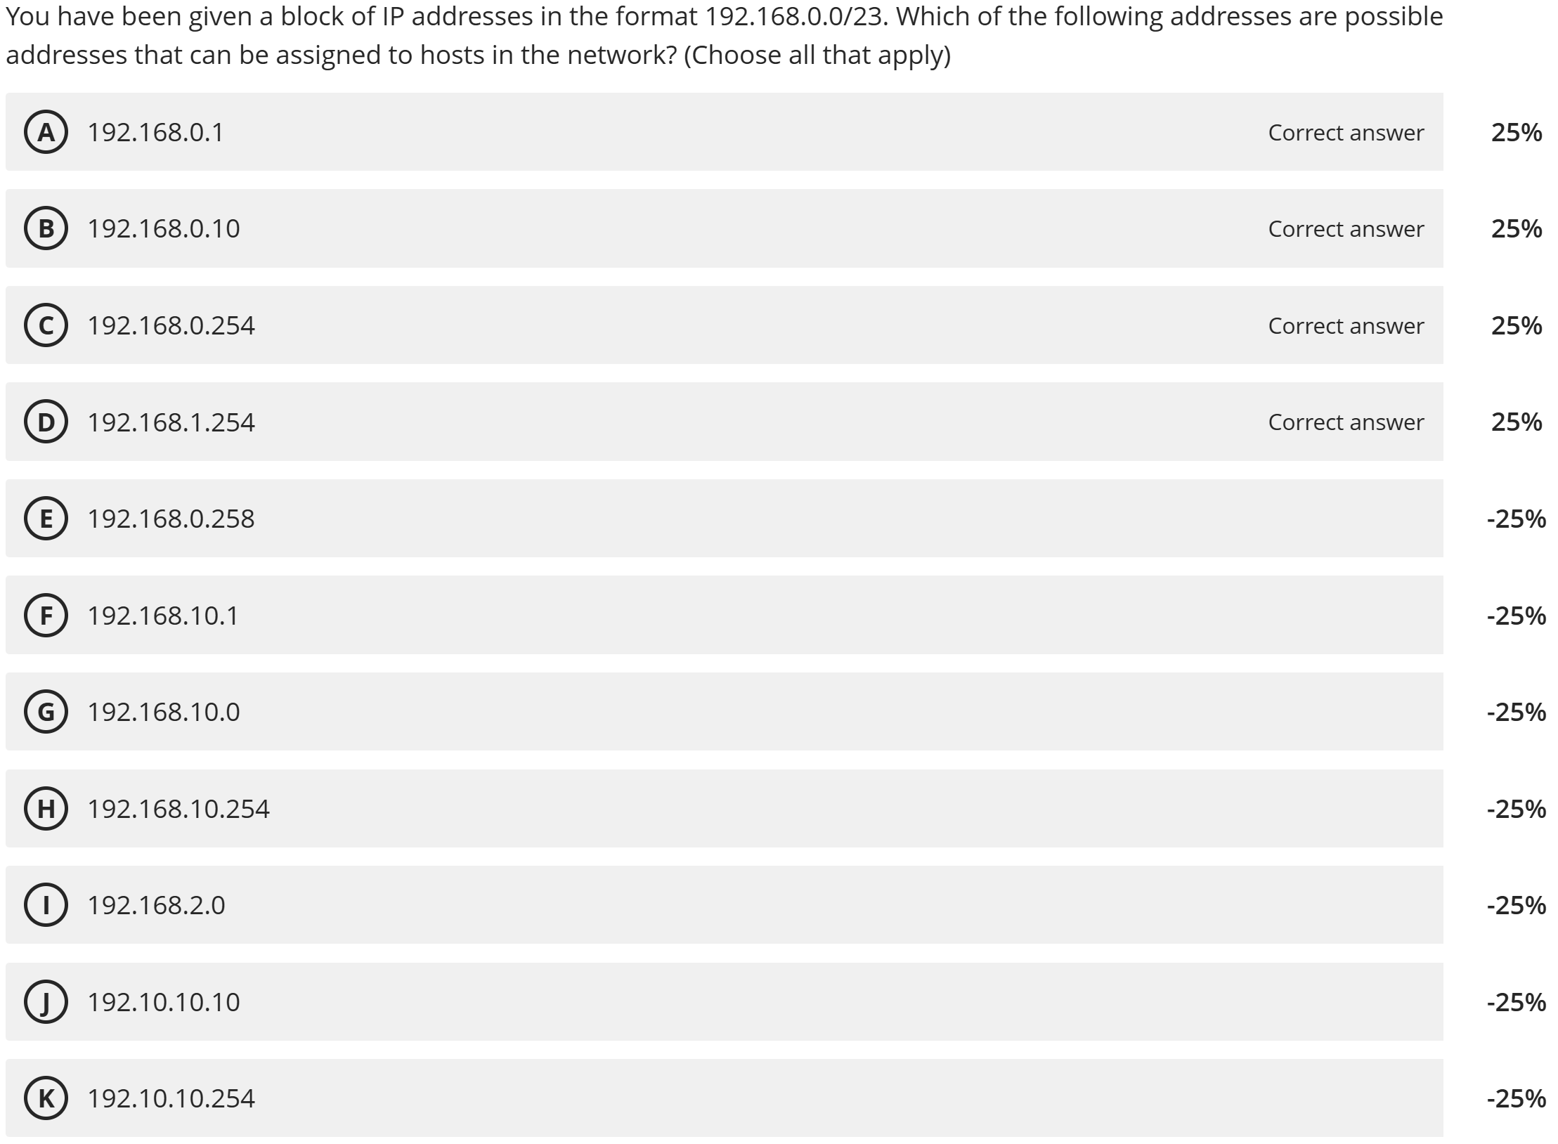
68.99% Correct

Slide 31
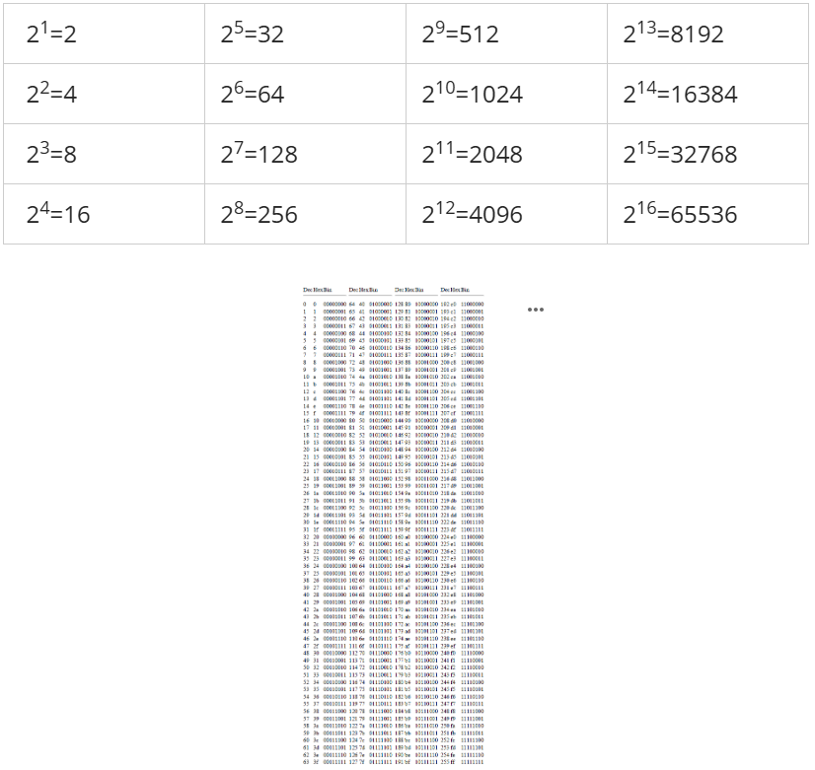

Slide 32
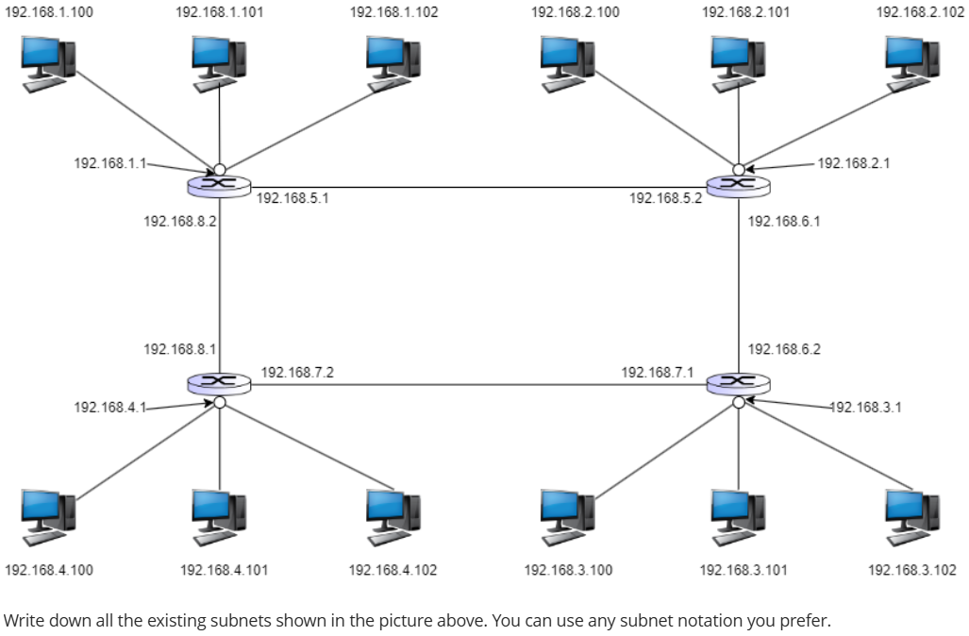
% Correct
64.41% Correct
192.168.1.x or 192.168.1.0/24 192.168.5.x or 192.168.5.0/30
192.168.2.x or 192.168.2.0/24 192.168.6.x or 192.168.6.0/30
192.168.3.x or 192.168.3.0/24 192.168.7.x or 192.168.7.0/30
192.168.4.x or 192.168.5.0/24 192.168.8.x or 192.168.8.0/30
Notes:
Do not type an IP address here. I asked for a subnet.

Slide 33

Subnets
223.1.1.0/24
223.1.2.0/24
to determine the subnets, remove all routers, creating islands of isolated networks
each isolated network is called a subnet
223.1.1.1
223.1.1.2
223.1.2.1
223.1.1.4
223.1.2.9
223.1.2.2
223.1.1.3
223.1.3.27
subnet
223.1.3.1
223.1.3.2
223.1.3.0/24
223.1.3.0/24
223.1.3.0
255.255.255.0
subnet mask: /24

Slide 34
Subnets
223.1.1.2
how many?
223.1.1.1
223.1.1.4
223.1.1.3
223.1.1.0/24223.1.2.0/24
223.1.3.0/24
223.1.7.0/24
223.1.8.0/24
223.1.9.0/24
223.1.9.2
223.1.7.0
223.1.9.1
223.1.7.1
223.1.8.1
223.1.8.0
223.1.2.6
223.1.3.27
223.1.2.1
223.1.2.2
223.1.3.1
223.1.3.2

Slide 35
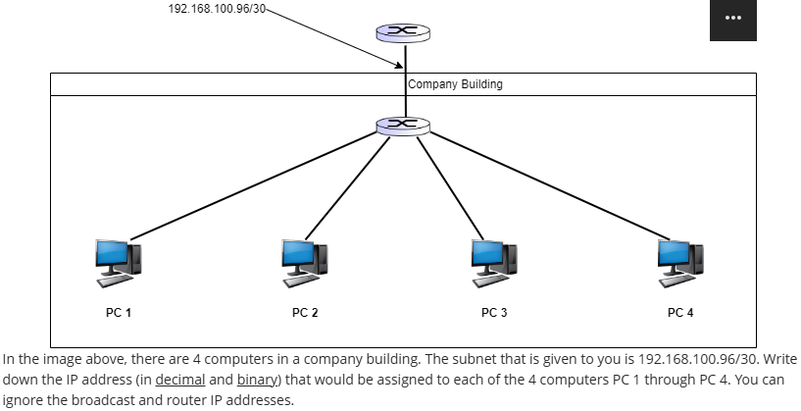
79.66% Correct
11000000.10101000.01100100.01100000 => 192.168.100.96
11000000.10101000.01100100.01100001 => 192.168.100.97
11000000.10101000.01100100.01100010 => 192.168.100.98
11000000.10101000.01100100.01100011 => 192.168.100.99
Notes:
Do not start with 97 and end with 100. That’s not a /30 subnet

Slide 36
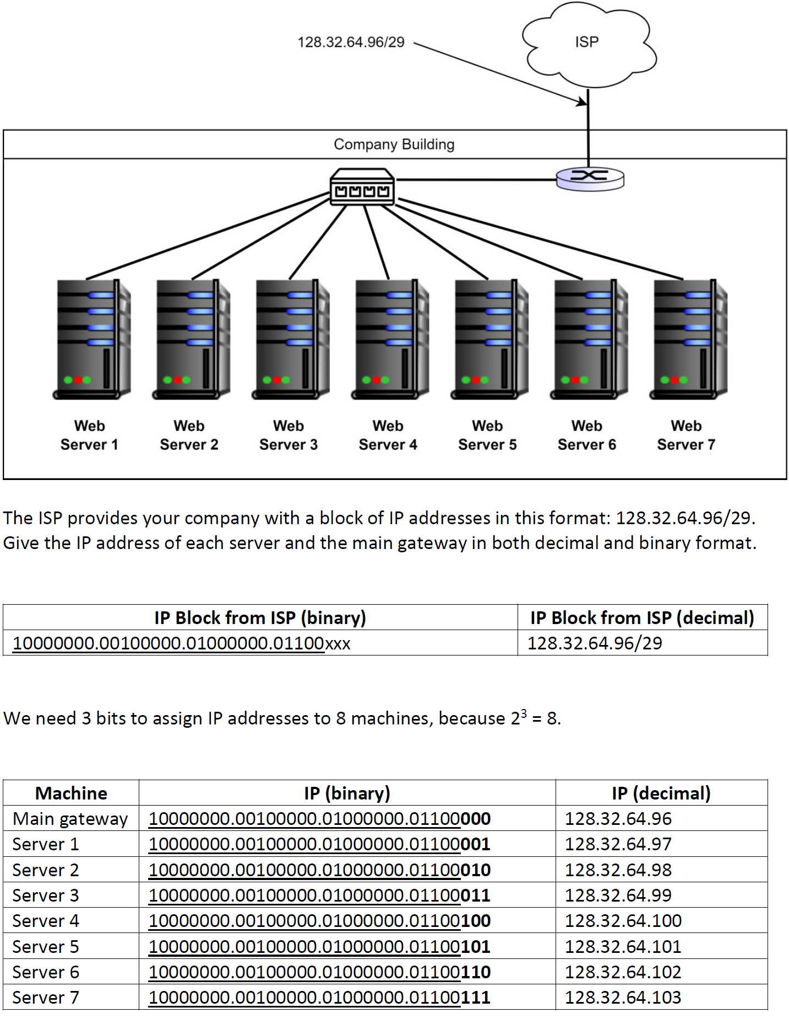
Subnets Exercise 1

Slide 37
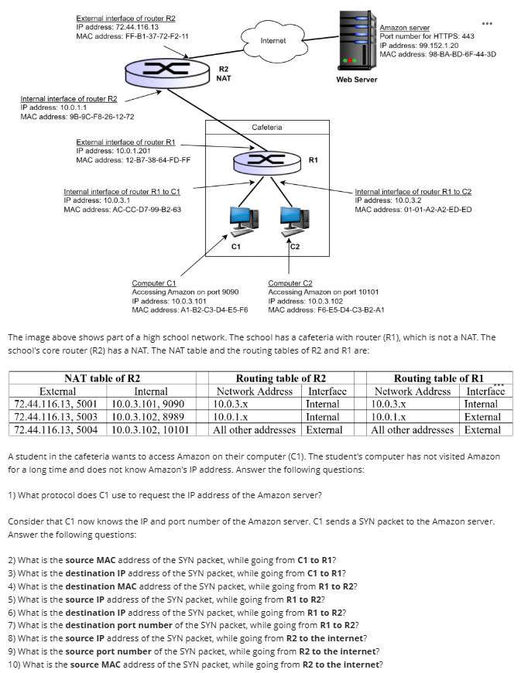
71.59% Correct
DNS
A1-B2-C3-D4-E5-F6
99.152.1.20
9B-9C-F8-26-12-72
10.0.3.101
99.152.1.20
443
72.44.116.13
5001
FF-B1-37-72-F2-11

Slide 38
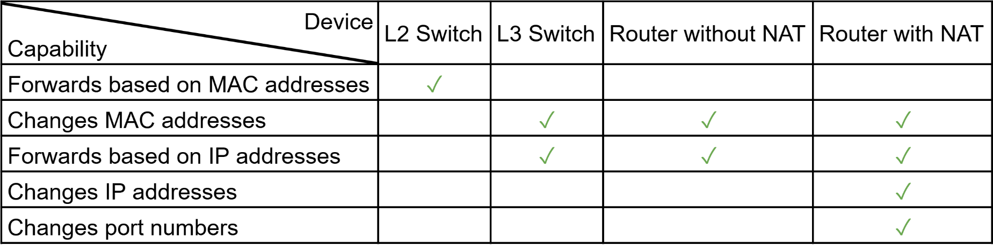
Networking Device Capabilities

Slide 39
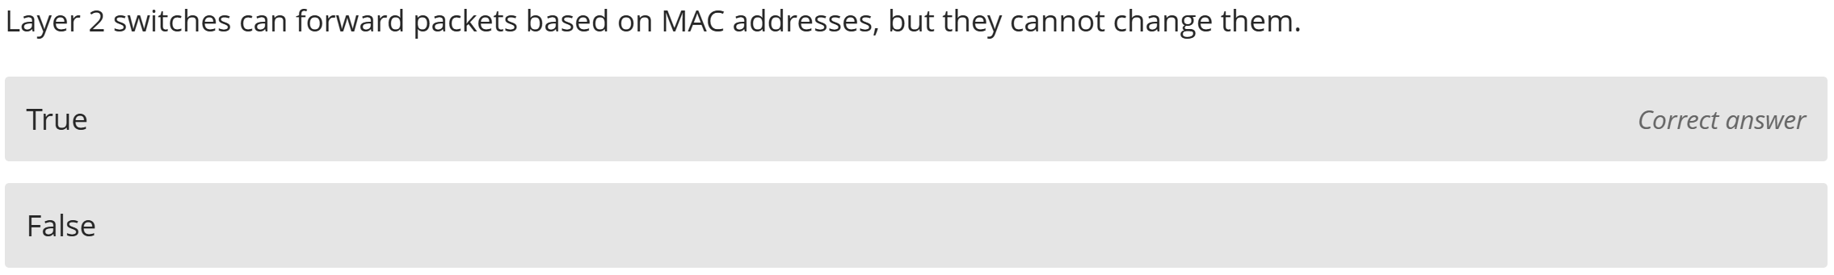
94.50% Correct

Slide 40
Networking Device Capabilities

Slide 41
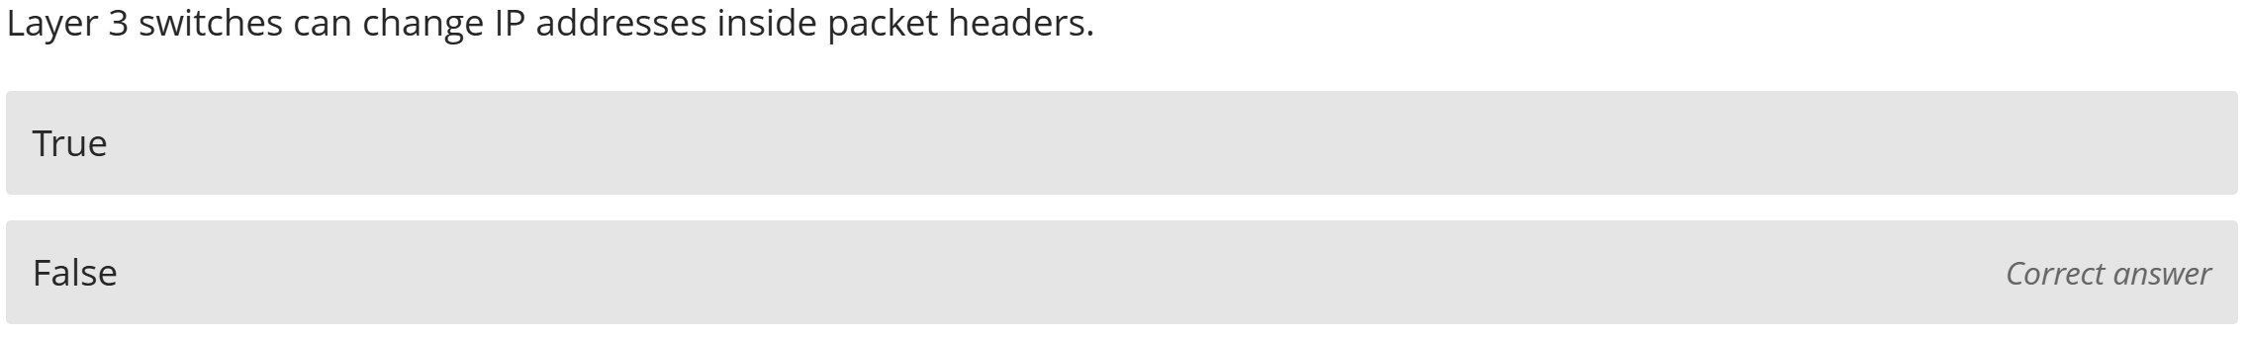
40.59% Correct

Slide 42
Networking Device Capabilities

Slide 43
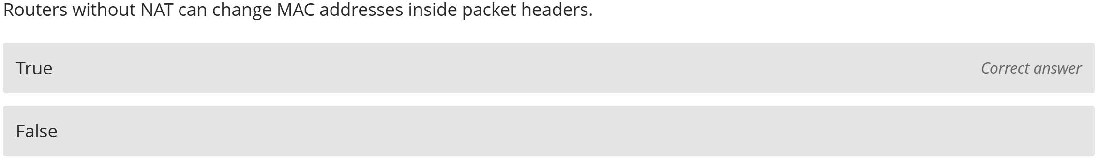
60.59% Correct

Slide 44
Networking Device Capabilities

Slide 45
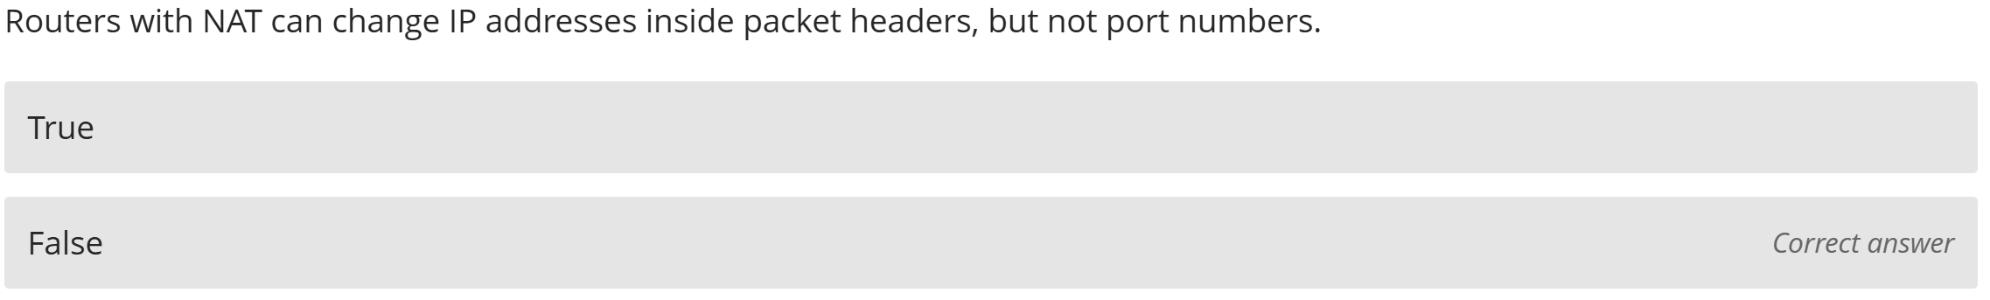
72.61% Correct

Slide 46
Networking Device Capabilities

Slide 47
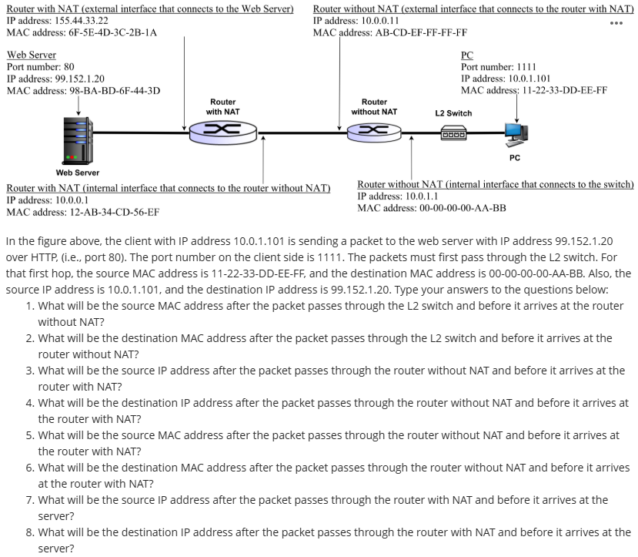
76.31% Correct
11-22-33-DD-EE-FF
00-00-00-00-AA-BB
10.0.1.101
99.152.1.20
AB-CD-EF-FF-FF-FF
12-AB-34-CD-56-EF
155.44.33.22
99.152.1.20

Slide 48
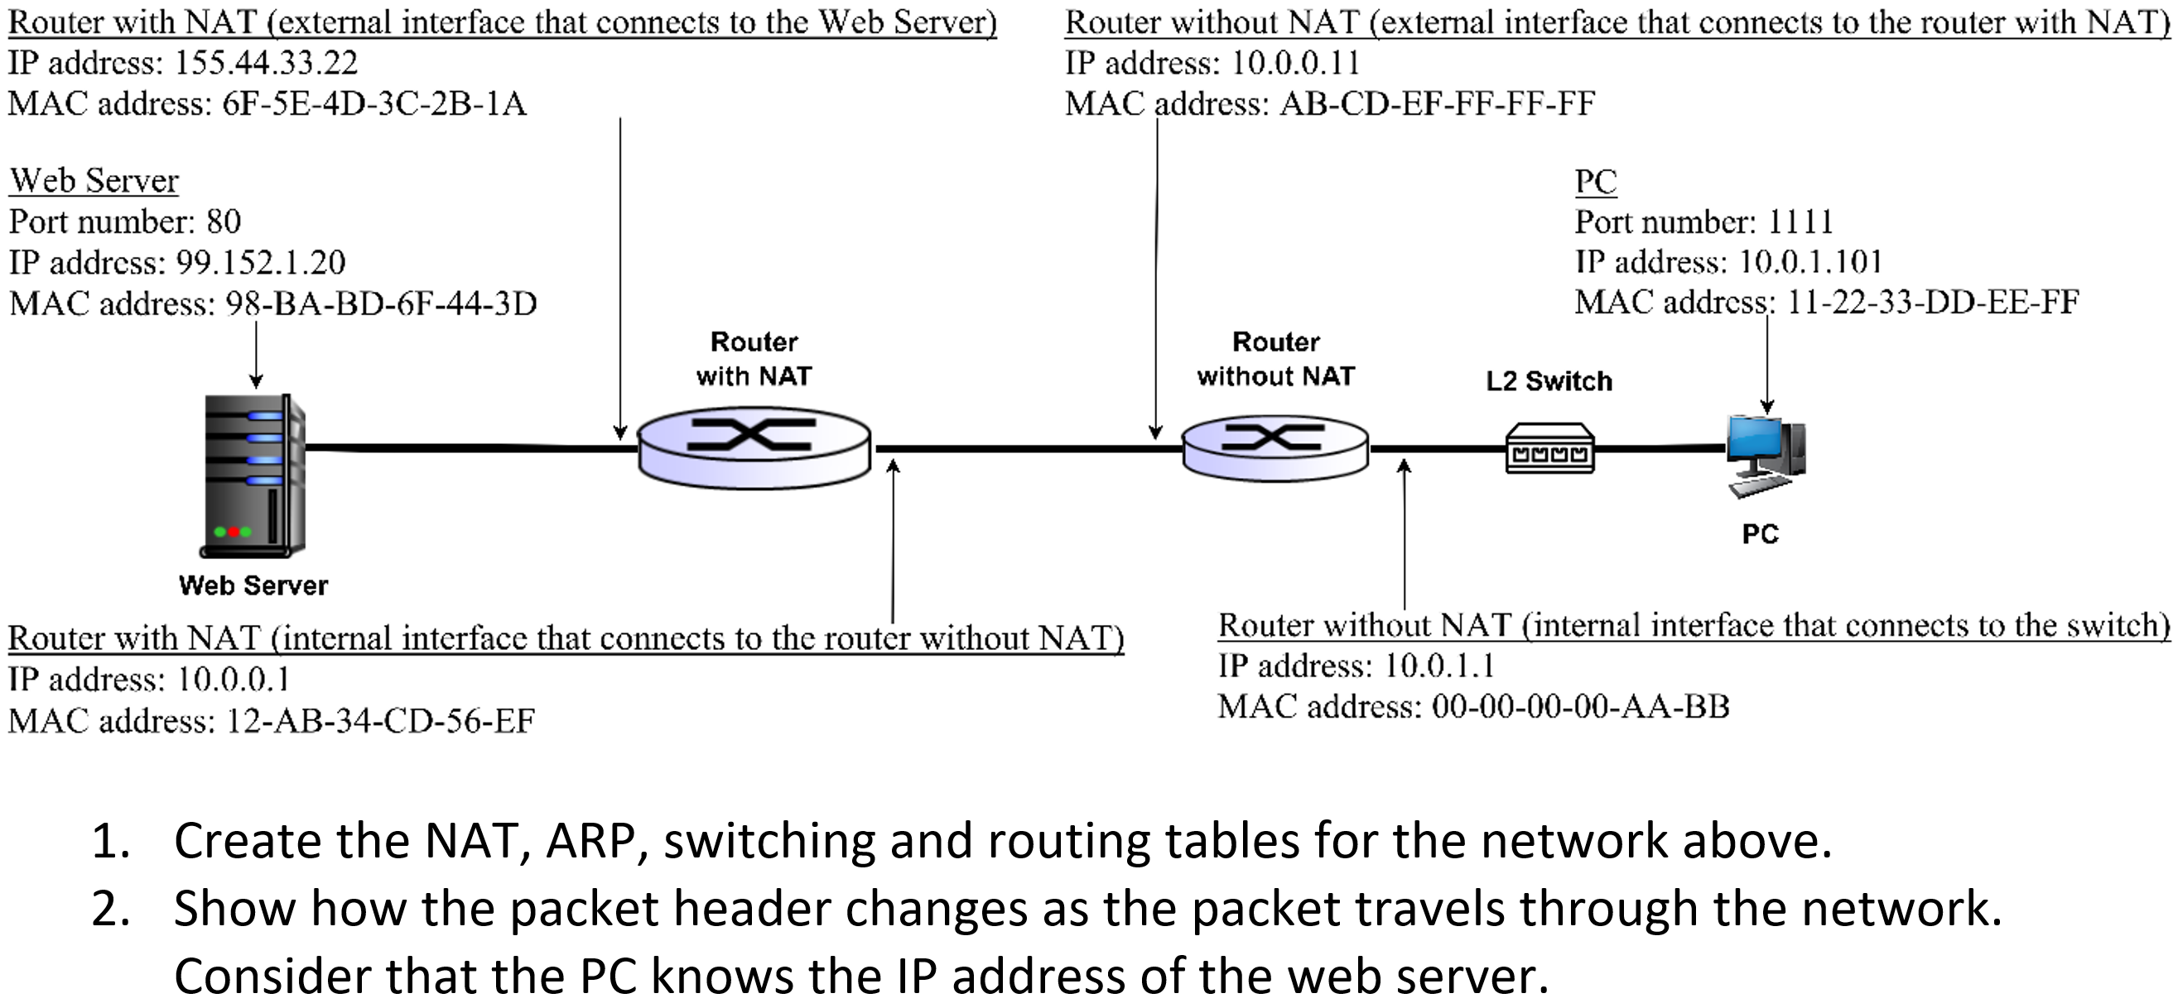
NAT, ARP, DNS, and Routing Exercise 1 & Quiz 8

Slide 49
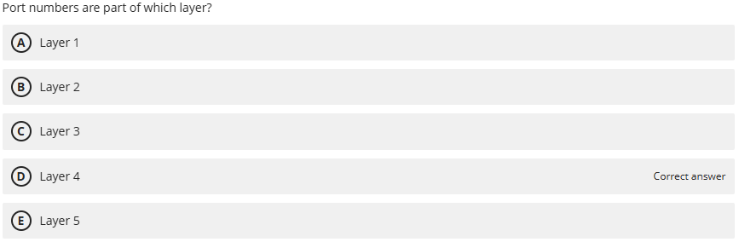
51.60% Correct

Slide 50
NAT: Network Address Translation
NAT translation table
WAN side addr LAN side addr
2: NAT router
changes datagram
source addr from
10.0.0.1, 3345 to
138.76.29.7, 5001,
updates table
1: host 10.0.0.1
sends datagram to
128.119.40.186, 80
138.76.29.7, 5001 10.0.0.1, 3345
…… ……
S: 10.0.0.1, 3345
D: 128.119.40.186, 80
10.0.0.1
1
2
S: 138.76.29.7, 5001
D: 128.119.40.186, 80
10.0.0.4
10.0.0.2
138.76.29.7
S: 128.119.40.186, 80
D: 10.0.0.1, 3345
4
S: 128.119.40.186, 80
D: 138.76.29.7, 5001
3
10.0.0.3
4: NAT router
changes datagram
dest addr from
138.76.29.7, 5001 to 10.0.0.1, 3345
3: reply arrives
dest. address:
138.76.29.7, 5001

Slide 51
67.72% Correct
22 bits in the subnet part
10 bits in the host part
2^10 possible combinations
1024 devices

Slide 52
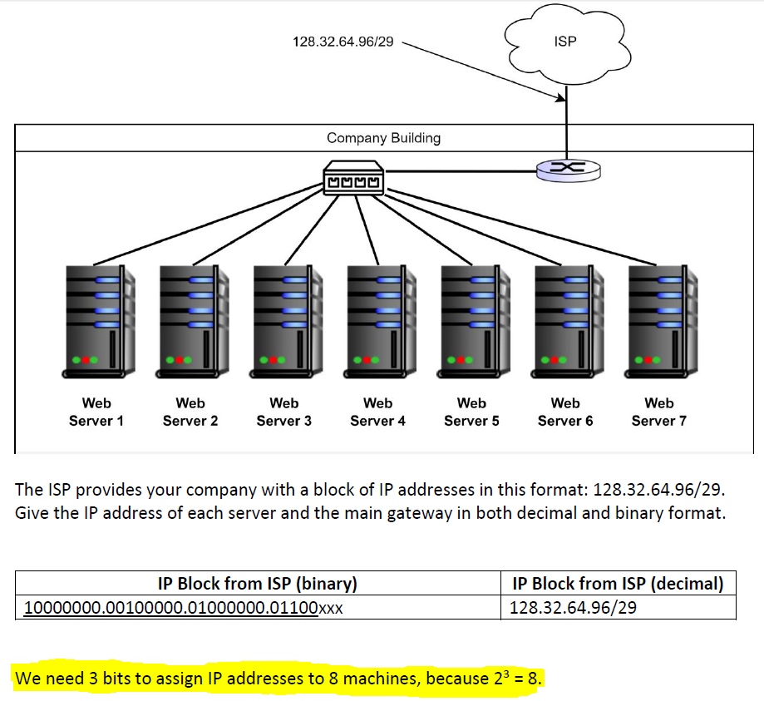

Slide 53
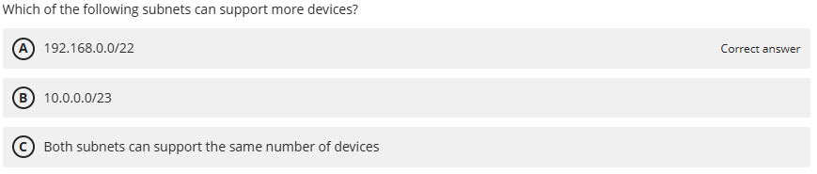
82.47% Correct
22 bits in the subnet part
10 bits in the host part
2^10 possible combinations
1024 devices
23 bits in the subnet part
9 bits in the host part
2^9 possible combinations
512 devices

Slide 54
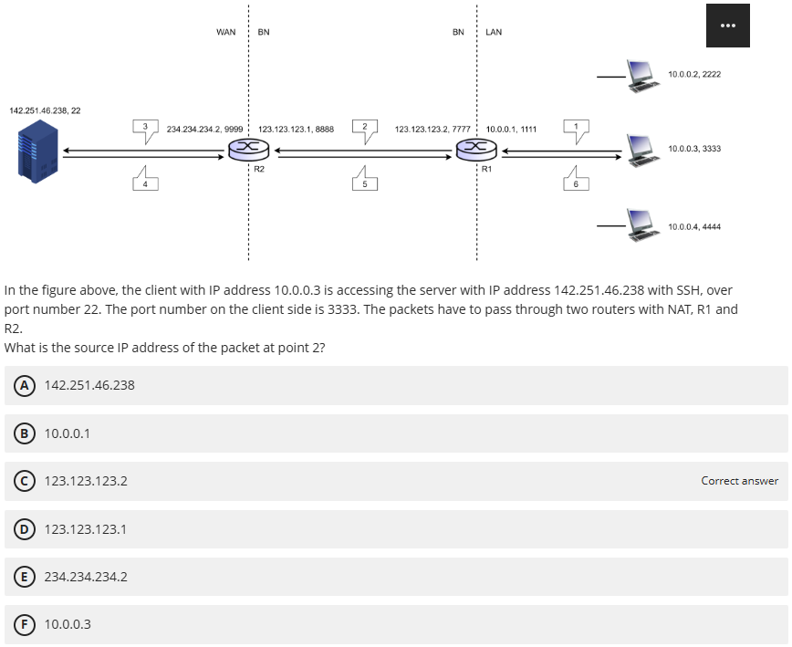
90.15% Correct

Slide 55
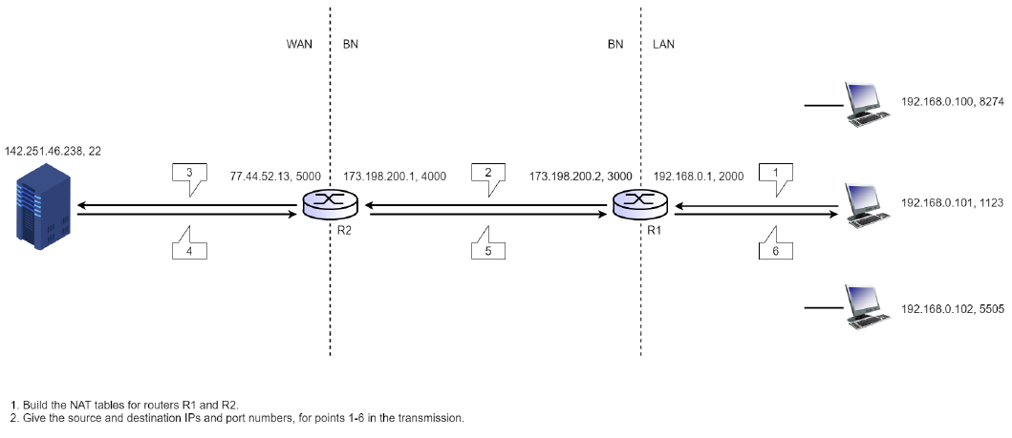
Subnets Exercise 1

Slide 56
Conclusions
Time was not an issue again
While preparing, you didn’t try to solve the exercises by yourselves
Start studying early for the final
The final exam will be cumulative
Pay attention in class
Highest score 590/600
I will curve the grades by 10 points

